Slide 1
Multi-tier Architecture
Project 2

Slide 2
Team Amber
Arthur G.
Jordi R
Kristina G.
Be creative!
Establish a multi-tier architecture.

Slide 3
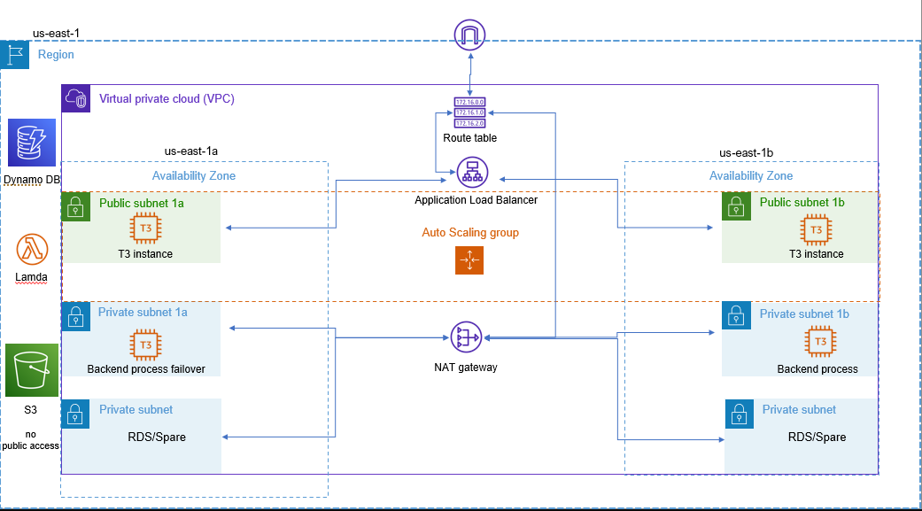

Slide 4
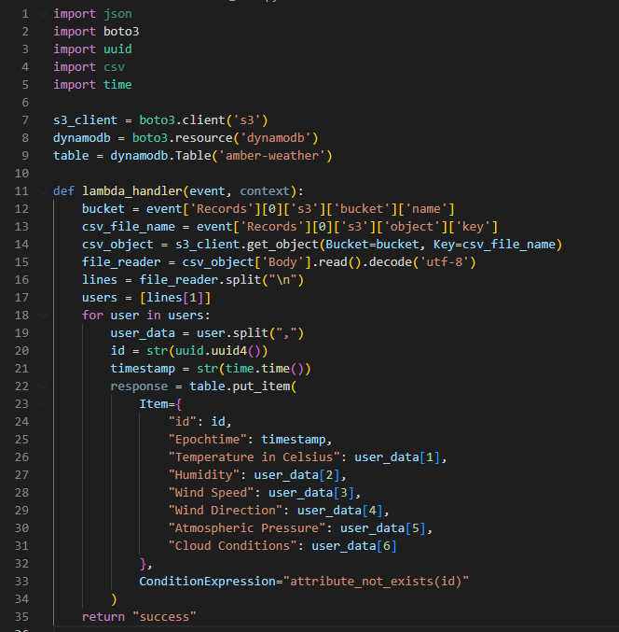
<Codes> Lambda

Slide 5
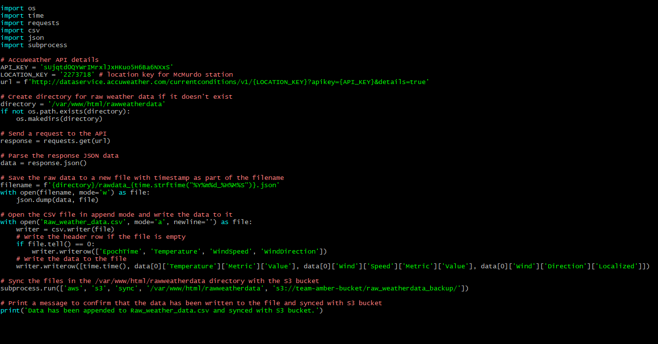
<Codes> Python in Linux

Slide 6
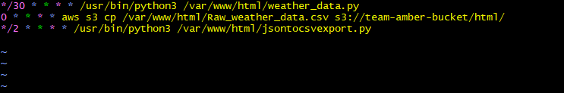
<CronTab>

Slide 7
Lessons Learned
Pay attention to scripting languages
Think ahead
-structure-
Research
Keep it simple
Keep it simple
Keep it simple

Slide 8
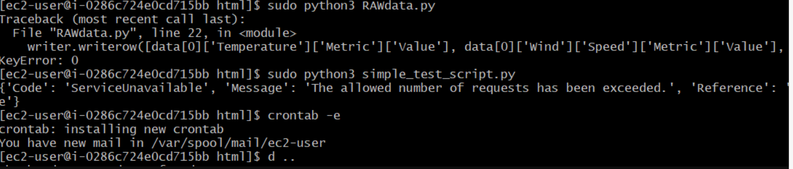
Achievement unlocked
Make the EC2 angry

